Slide 1


Active Learning
Presents

Slide 2
Smarties:
Ciaran Daly
Hajar Alzahrani
Juhaina Aljashmi
Saira Barlas
Bianca-Denise Lazar

Slide 3

Outline
the art of active learning
memory
study tips and tricks
exercise to blend it all

Slide 4


Active Learning: Become Part Of The Action!

Slide 5
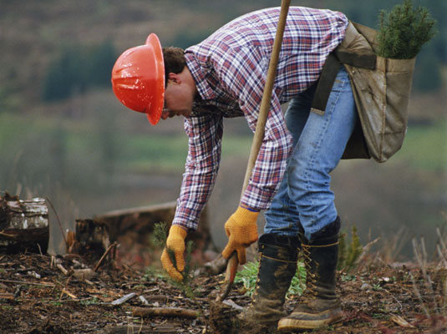






Ideal Recipe!
We learn by doing
We make our own meaning
We are at the centre of the learning process
We feel driven
We feel secure
We develop a positive attitude

Slide 6

Students learn best what they teach.
Importance?

Slide 7
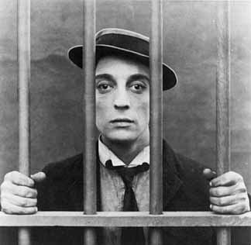
The Barriers
class time
preparation time
nerve to introduce active learning to large group
enough knowledge

Slide 9

“Tell me and I’ll forget,
Show me and I may remember,
Involve me and I’ll understand”
--- Chinese proverb

Slide 10
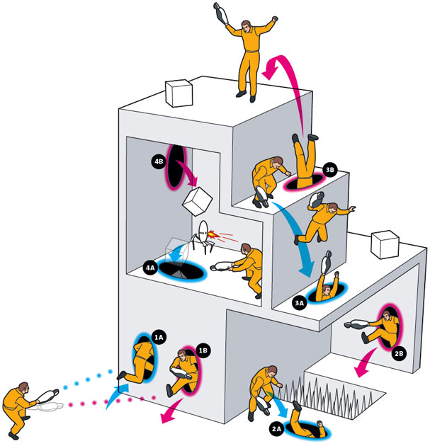
Common Effective Strategies
Individual Activities
Paired Activities
Questions & Answers
Cooperative Learning Exercises

Slide 11

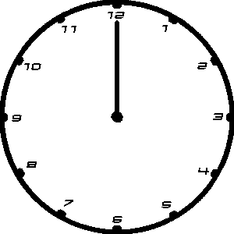
Individual Activities
I was surprised that...
I wonder about...
the “One Minute Paper”
response to a demonstration
I learnt that...

Slide 12
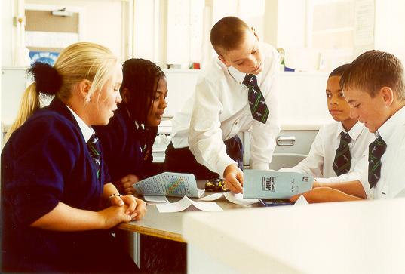

Paired Activities
think OR write/pair/share
evaluation of another student’s work

Slide 13


Questions & Answers
wait time
student summary of another student’s answer

Slide 14
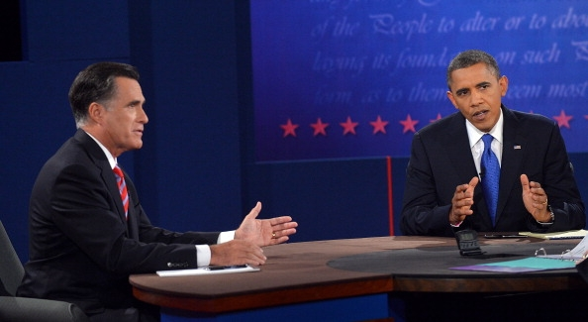
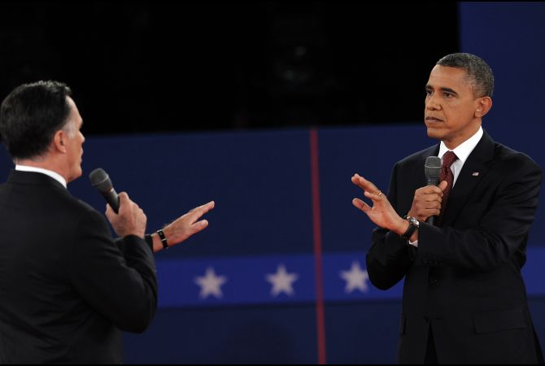
Cooperative Learning Exercises
debates
panel discussions

Slide 15

“Most of us know how to be taught, we haven’t learned how to learn”

Slide 16

What Type Of Learner Are You?

Slide 17



Personal Active Learning
Go Online!
Self Analysis!
Active Listening!

Slide 18


Learning
Passive Learning
Active Learning
Repeat
Reflect
Relying on others
Bored and tired
Link
Self evaluation
Independent
Fully engaged

Slide 19






Role Of The Student
Passive Learner
Active Learner
Remember
Note-Taker
Absorb Knowledge
Think
Discover
Construct Knowledge

Slide 20






Role Of The Student
Passive Learner
Active Learner
Lack
Observe
Experience
Participate

Slide 21

Active Learning And Memory

Slide 22
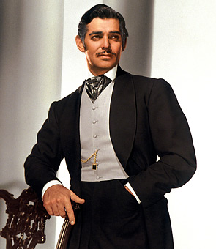


“Remember, Remember ...”
Young
Old
SMASHED
VS.
Mr. Gable

Slide 23

The Big Question
Memory
Profit

Slide 24
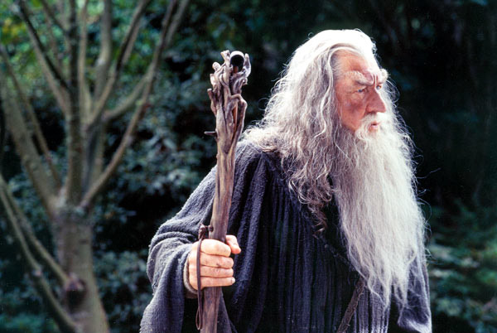

3 Major Stages
Information Storage
Information In
Information Recall
Mental Transformation
~

Slide 25
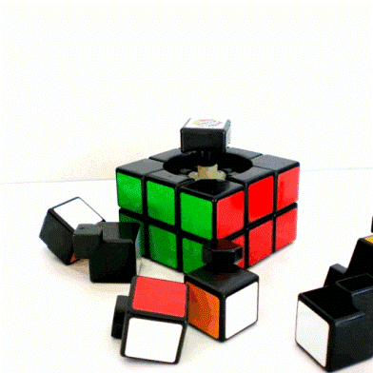





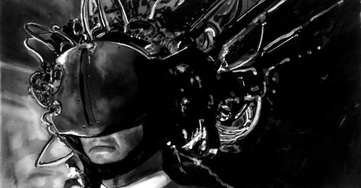
Memory Aids
Mnemonics
Explaining
Meaning

Slide 26
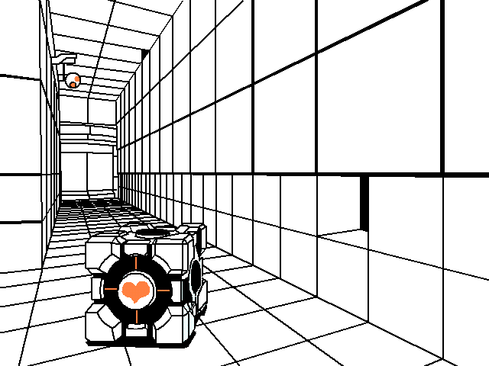
Memory + Active Learning Combo
Memory | Active Learning
Information In | Attend To It
Information Storage | Store It
Information Recall | Retrieve It
Active Learning
Attend To It
Store it
Retrieve It

Slide 27



Active Learning, The Highway
be organised
time on task
study groups
self criticise
know your learning style
independence & self reliance as a student

Slide 28














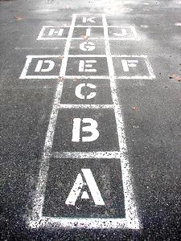



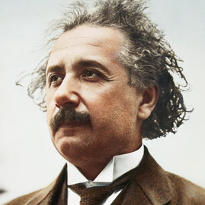

What Really Matters?

Slide 29


Conclusion
incredibly effective
very Interesting
more fun

Slide 30


Activity
+
Learning
=
Success

Slide 31


